Slide 1
Debugging in IntelliJ IDEA

Slide 2
Debugging
IntelliJ IDEA debugger helps with detecting and fixing bugs in your Java program
The debugger will most likely interfere with program execution
The debugging process is as follows:
Indicate where program needs to stop
Run the Java program in debug mode
Obtain debugger information and how it affects program execution
Fix the bug

Slide 3
Breakpoints
You will use breakpoints to indicate points where program execution is suspended
You can delete or disable the breakpoints
Breakpoints available in IntelliJ are
Line breakpoints – program execution is suspended upon reaching a specified line of code
Method breakpoints – program execution suspended upon entering or exiting method
Field watchpoints – program execution suspended upon reading or writing to specified field
Exception breakpoints – program execution suspended when Throwable and its associated subclasses are thrown
Source: jetabrains.com, 2020

Slide 4
Breakpoint Statuses
Verified – debugger has confirmed program can be suspended
Warning – there are issues related to breakpoint
Invalid – debugger confirmed program cannot be suspended
Inactive – configured to be inactive until another breakpoint is hit
Muted – temporarily inactive
Disabled – breakpoint configured to be disabled
Source: jetabrains.com, 2020

Slide 5
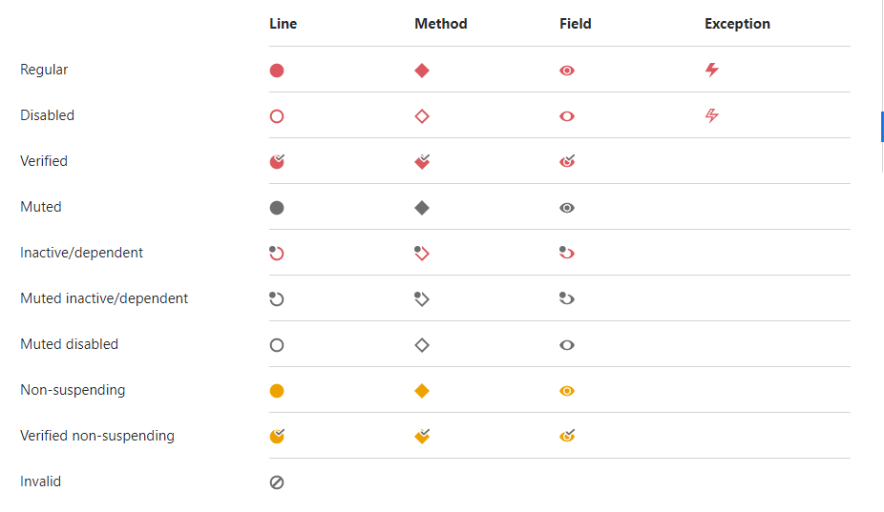
Breakpoint Icons
Source: jetabrains.com, 2020

